Slide 1
Radios For The Newly Licensed
Or, How To Spend Your Money Somewhat Wisely…

Slide 2
You’ve got your license… NOW WHAT?!?!?!?!
So many choices!
New stuff is pricey (but reliable and comes with a warranty)
Old stuff is reasonably priced (but who knows what shape it is in?)
How do you avoid wasting money?
  When you find out, please let me know…
  After 40-plus years in the hobby I can guarantee I’ve wasted more than you
Know what you are spending your money on, and what it will let you do, BEFORE you buy.

Slide 3
It’s a SOCIAL hobby, not just a technical one!
Some amateurs enjoy tinkering, experimenting, building, rebuilding, repairing and designing.
  For them, almost anything will do – they are going to take it apart anyway…
Others enjoy talking to their friends, meeting new people, and being part of a social network.
  For them reliability is key – spending time re-configuring, re-programming and/or repairing equipment is time not spent on the air.
Here are some NEW choices from reputable manufacturers that will serve you well.
  Used gear of near-new vintage can do fine… if it is in good shape!

Slide 4
Things you can do with different types of radios (in a general sense…)
Hand-held VHF/UHF radios
  Talk across a fairly short distance – perhaps a mile without using a repeater
  Talk through a repeater (if you are in range of one) covering a large area depending on where the repeater is located. Repeaters with digital modes may link to wider areas.
Mobile/home VHF/UHF radios
  With a larger antenna can cover tens of miles without a repeater or access a repeater from even further away.
Home HF radios
  Can talk around the country or around the world when conditions permit.
  Require larger antennas (can be as simple as a wire between two trees)

Slide 5
Handheld VHF/UHF radios
The least expensive choice, also the most common
Also, the most restrictive – limited to talking to people or repeaters nearby
Major manufacturers with excellent reputations and warrantees:
  Yaesu (has a digital option called C4FM or Fusion)
  Kenwood (has a digital option called D-STAR)
  iCom (has a digital option called D-STAR)
Also have proven to be good values:
  Bridgecom (has a digital option called DMR)
  Anytone (has a digital option called DMR)
Other choices include used Motorola (very reliable) and many Chinese radios (can use the digital DMR mode.)

Slide 6
Examples of handheld radios
Yaesu
  FT-65, covers 2M/70cM, analog FM only, $110
  FT-60R, covers 2M/70cM, analog FM only, $160
  FT-4XR, covers 2M/70cM, analog FM only, $95
  FT-5DR, covers 2M/70cM, analog FM and C4FM, $390
  FT-70DR, covers 2M/70cM, analog FM and C4FM, $170
Anytone
  D-168UV, covers 2M/70cM, analog FM and DMR, $200
  D878UVII+, covers 2M/70cM, analog FM and DMR, $335
Other decent choices from Alinco, both analog and DMR

Slide 7
Mobile/Home VHF/UHF Radios
More features, bigger screens, dedicated buttons instead of a menu many items deep
More power = greater range
Requires an outside antenna and a power supply or vehicle power
Major manufacturers with excellent reputations and warrantees:
  Yaesu (has a digital option called C4FM or Fusion)
  Kenwood (has a digital option called D-STAR)
  iCom (has a digital option called D-STAR)
Also have proven to be good values:
  Anytone (has a digital option called DMR)
Other choices include used Motorola (very reliable)

Slide 8
Examples of mobile/home VHF/UHF radios
Yaesu
  FTM-150, 2M/70cM analog FM, 50 watts output, $420
  FTM-6000, 2M/70cM analog FM, 50 watts output, $300
  FTM-510, 2M/70cM analog FM and C4FM, 50 watts output, $750
  FTM-500, 2M/70cM analog FM and C4FM, 50 watts output, $550
Icom
  Ic-2730, 2M/70cM analog FM, 50 watts output, $310
Anytone
  D578-UVIII+, 2M/70cM + 220 analog FM and DMR, 50 watts output, $485
Other decent choices from Alinco, both analog and DMR

Slide 9
Home HF Radios
Work the world (depending on conditions…)
Needs an outside antenna and a power supply
  Might need an antenna tuner, or it might be in the radio already
Allows you to use voice, CW and many digital modes
  VARA HF, PSK, FT8, JSCall, RTTY… all with a sound card that might be in the radio already
Opens a world of operating activities
  DX – making contacts with stations in as many countries as you can
  Contesting – making as many contacts as you can in a fixed period of time
  Certificate chasing – Making contacts to gain awards

Slide 10
Example of home HF radios
Yaesu FT-710-Field $975
  100 watts output, all bands, all modes, built in bandscope
  Built-in antenna tuner
  Built-in soundcard for digital modes
Icom ic-718 $860
  An older design but still very useable, no bandscope
  Requires external antenna tuner
  Requires external soundcard for digital modes
Both of these require a power supply ($150-200) and one or more antennas and feedlines ($100-200)

Slide 11
Making a choice
After looking at the options, decide how much you want to spend
  Once you have a radio for a while, you may decide to buy a better one.
  You can generally expect to sell your used radio (depending on age and condition) for roughly half (or more) of the new price.
Who do you want to talk to?
  Handheld radios talk locally
  Mobile radios do that better
  HF radios talk around the country and around the world.
More capability = more $

Slide 12
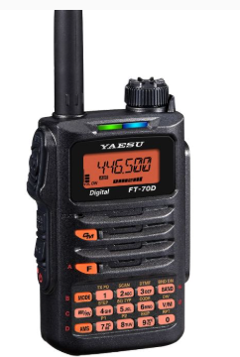
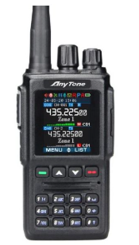
I want to talk locally with a handheld:
Yaesu
  FT-70DR, covers 2M/70cM, analog FM and C4FM, $170
Anytone
  D-168UV, covers 2M/70cM, analog FM and DMR, $200

Slide 13
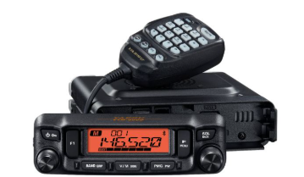
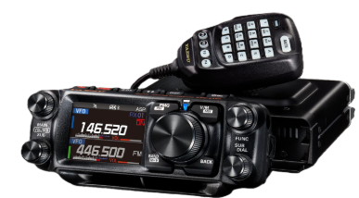
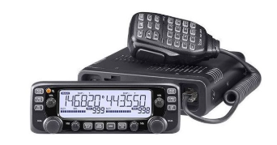
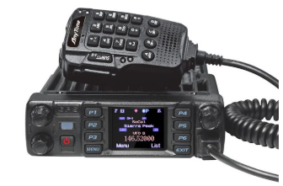
I want to have a radio in my car:
Yaesu
  FTM-6000, 2M/70cM analog FM, 50 watts output, $300
  FTM-500, 2M/70cM analog FM and C4FM, 50 watts output, $550
Icom
  Ic-2730, 2M/70cM analog FM, 50 watts output, $310
Anytone
  D578-UVIII+, 2M/70cM + 220 analog FM and DMR, 50 watts output, $485

Slide 14
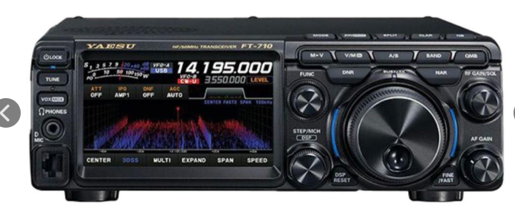
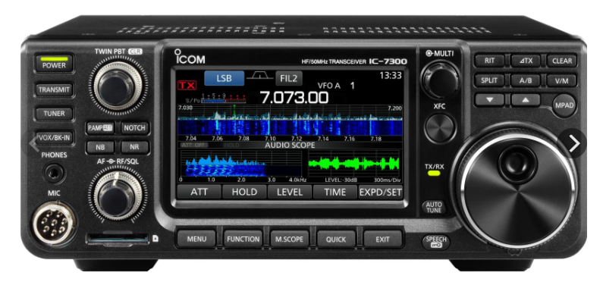
I want to work the world (maybe using CW!)
Yaesu FT-710-Field $975
  100 watts output, all bands, all modes, built in bandscope
  Built-in antenna tuner
  Built-in soundcard for digital modes
For an extra $115 over the IC-718 you get a built-in tuner and built-in soundcard, plus a bandscope.
The Icom IC-7300 has all these features at a price of $1000, another fine choice.

Slide 15
Too much $$$$ ! What about used radios?
Ham Radio Outlet has used, tested gear on-line
  30-day warranty
  Also open-box, consignment and discontinued items
What about rolling the dice?
  Private sales, in person or at a flea market *CAN* yield good value
    Do you know the seller?
    Does someone else know them?
    Are they willing to offer some sort of return?
    If “NO” to the above, price your offer according to your risk!
Avoid anything more than 15-20 years old – tough to repair
Avoid on-line used gear sales until you have more experience

Slide 16
What to look for in used radios (under 20 years old!)
Handhelds: Yaesu, Icom, Kenwood, Anytone.
  Look for at least 2 meters and 70 centimeters
  At least 4 watts output
  Avoid Motorola (hard to program) and Chinese radios (Baofeng, etc. – cheap to buy new)
Mobile radios: Same makes as above.
  Look for at least 2 meters and 70 centimeters
  At least 25 watts output
HF radios
  Yaesu, Icom, Kenwood, Elecraft, Ten-Tec
  160-10 meters
  100 watts – anything less is frustrating when you are starting out

Slide 17
Questions?
Thanks for your attention!
Vendors:
DX Engineering: dxengineering.com
Ham Radio Outlet: hamradio.com
Gigaparts: gigaparts.com
My email: chandlerusm@gmail.com

